Slide 1
Programming Fundamentals
BY
Adnan Amin
Lecturer, IMSciences, Peshawar

Slide 2
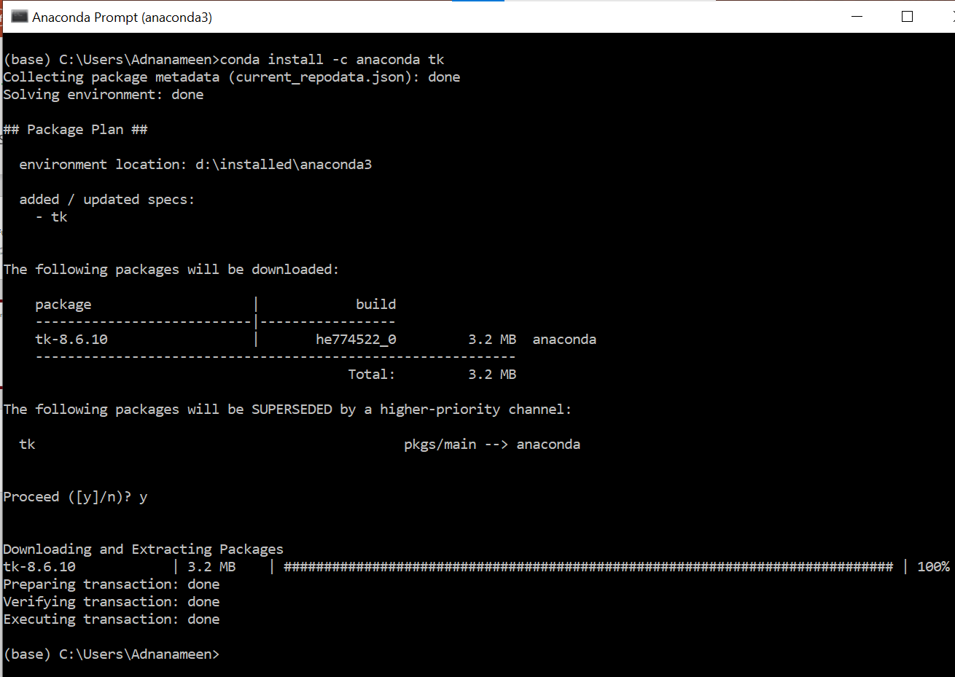
GUI: Graphical User Interface
How to install Tkinter: TK interface
conda install -c anaconda tk

Slide 3
Graphical User Interface
It allows the user to interact with the operating system and other programs using graphical elements such as icons, buttons, and dialog boxes.
For many years, the only way that the user could interact with an operating system was through a command line interface (CLI).
Much of the interaction with a GUI is done through dialog boxes, which are small windows that display information and allow the user to perform actions.
Python does not have GUI programming features built into the language itself.

Slide 4
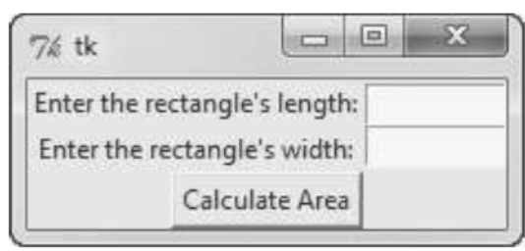
GUI programs Are event-Driven
GUI programs must respond to the actions of the user, it is said that they are event-driven.
The user causes events to take place, such as the clicking of a button, and the program must respond to the events.

Slide 5
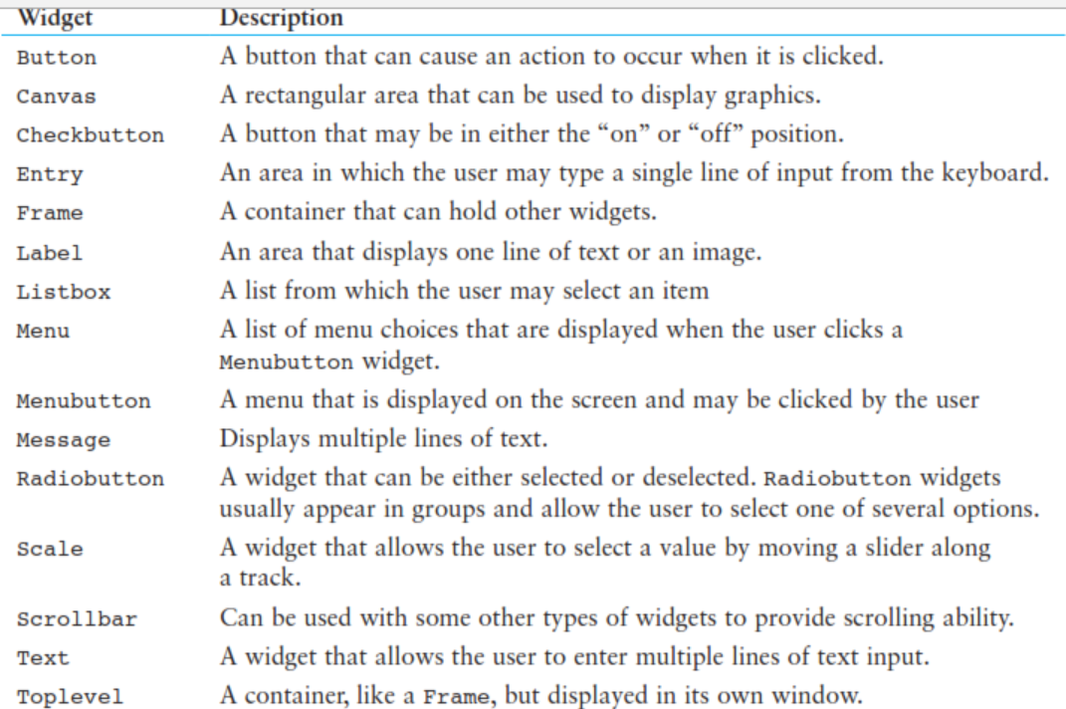
Using the tkinter Module
In Python you can use the tkinter module to create simple GUI programs.
The name “tkinter” is short for “Tk interface.”

Slide 6
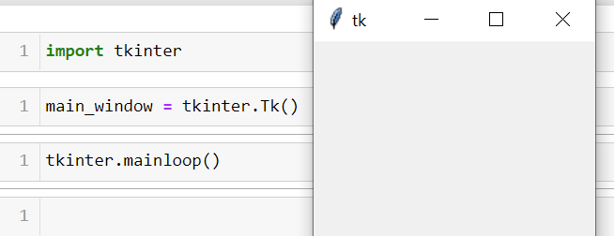
This program displays an empty window
tkinter.Tk( ): creates an instance of the tkinter module’s Tk class and assigns it to the main_window variable. This object is
the root widget, which is the main window in the program.
mainloop( ): This function runs like an infinite loop until you close the main window.

Slide 7
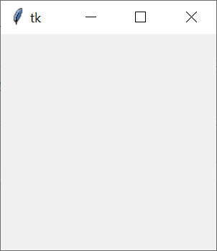
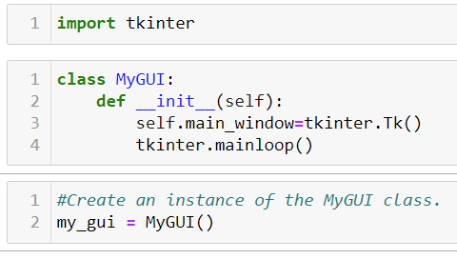
When an instance of the class is created, the GUI appears on the screen.
it is a common practice to write a class with an _ _init_ _ method that builds the GUI.

Slide 8
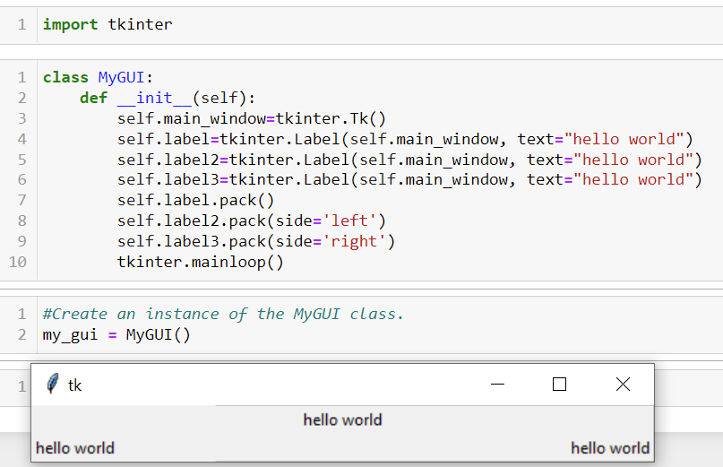
Display text with Label Widgets
You use the Label widget to display text in a window.
pack(side=‘left’) : by default pack( ), or must be top, bottom, left, or right

Slide 9
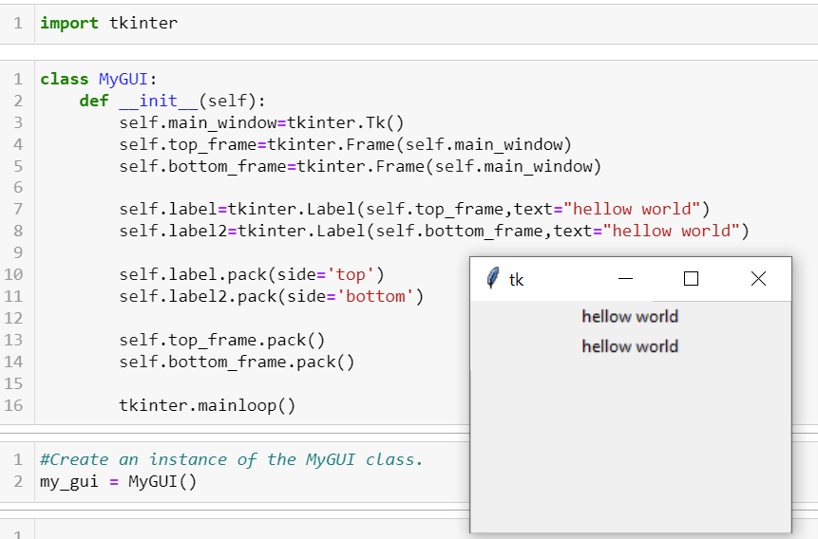
Organizing Widgets with Frames
A Frame is a container that can hold other widgets. You can use Frames to organize the widgets in a window.

Slide 10
Button Widgets and Info Dialog Boxes
You use the Button widget to create a standard button in a window.
When the user clicks a button, a specified function or method is called.
An info dialog box is a simple window that displays a message to the user and has an OK button that dismisses the dialog box.
You can use the tkinter.messagebox module’s showinfo function to display an info dialog box.
from tkinter import messagebox

Slide 11
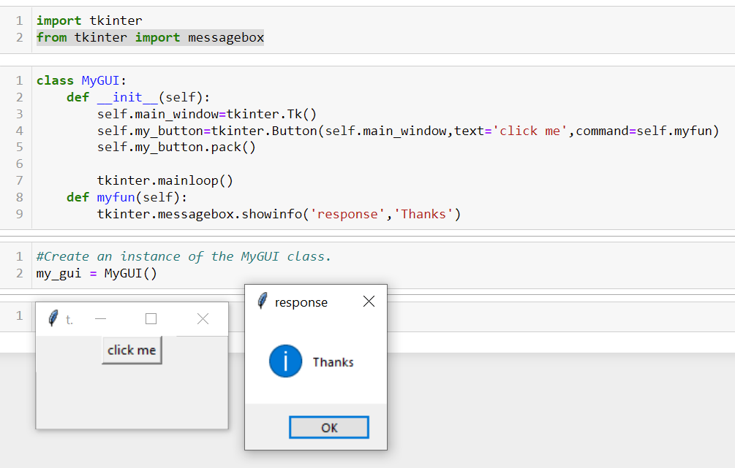

Slide 12
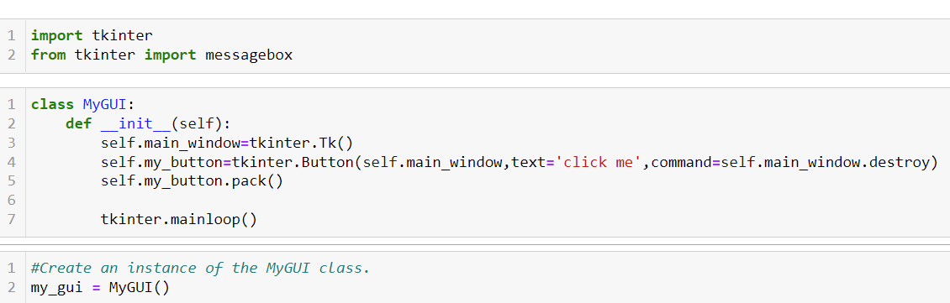
Creating a Quit Button

Slide 13
Getting Input with the Entry Widget
An Entry widget is a rectangular area that the user can type input into. You use the Entry widget’s get method to retrieve the data that has been typed into the widget.
The formula for converting kilometers to miles is:
Miles = Kilometers x 0.6214

Slide 14
